Slide 1

PowerFleet Enterprise
Access Control
OSHA and Equipment Checklists
Safety and Impact Monitoring
Use and Productivity
Lift, Speed and Location Sensing
Business Analytics

Slide 2

About I.D. Systems
Through innovative design, engineering discipline, and customer relationships we create the industry’s highest quality products.
CORE VALUES:
Trust, Respect, Honest Communication, Teamwork
Criticality of our faults and accountability for them
Rational approach and data driven decisions
Lead by example

Slide 3



Our Business
Our Focus is to improve safety & security, reduce operating & capital costs, and optimize efficiency & productivity.
The PowerFleet® division is focused on telematics systems for industrial trucks, creating a culture of safety, driving robust analytics for intelligent decision making.
Our logistics visibility solutions focus on the full suite of transportation – from the asset (truck & trailer) to the cargo within, including a new line of sight into the status of the goods.
Our connected vehicle solutions help track and analyze asset location, condition, accident diagnostics, who the operator is, and how often they’re being used.

Slide 4






























Some of Our Customers
DISTRIBUTION
RETAIL
MANUFACTURING
AUTOMOTIVE
GOVERNMENT
TRANSPORTATION
AVIATION
RENTAL CAR

Slide 5




PowerFleet for Industrial
PowerFleet Enterprise
Analytics
Safety
Compliance
Productivity
Optimization

Slide 6
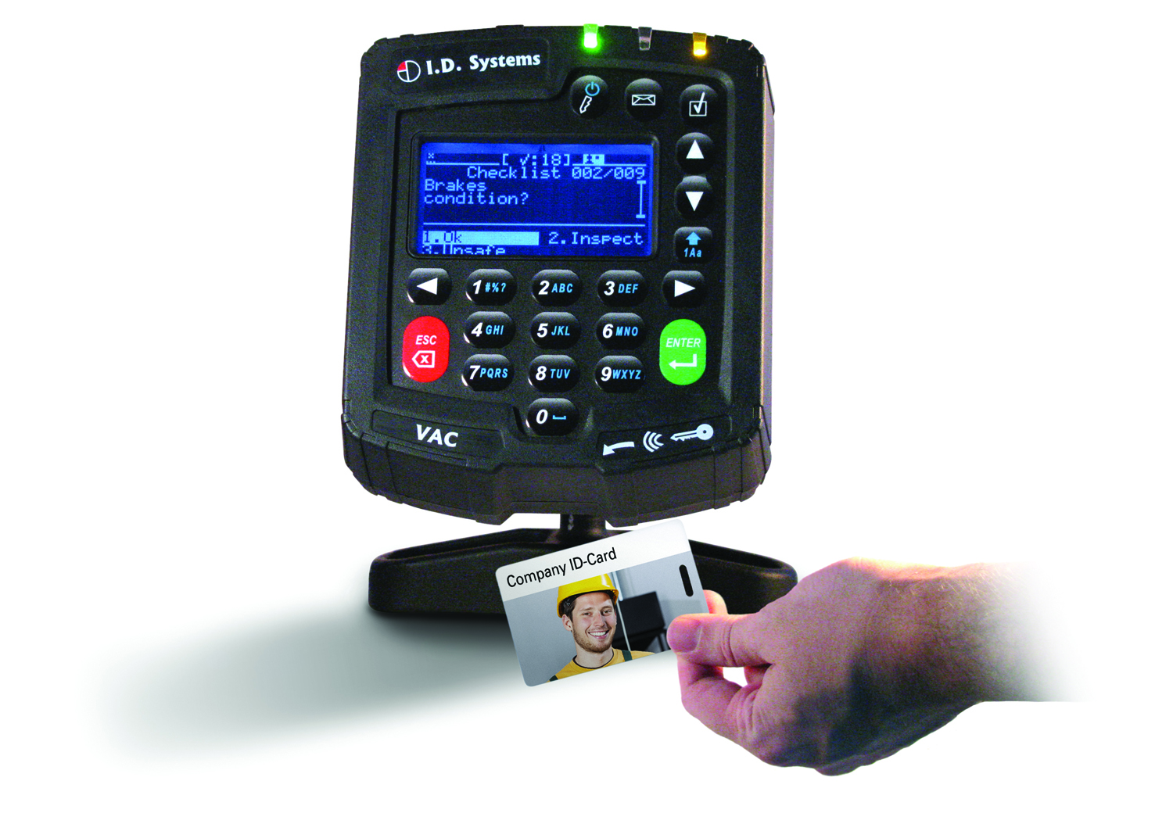
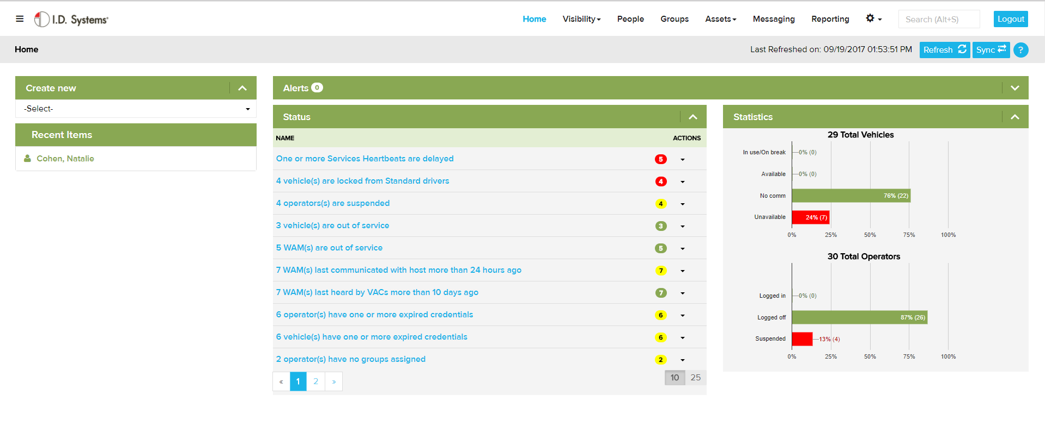
PowerFleet Enterprise Functional Capabilities
Base System
Access Control
Electronic Safety Checklist
Impact Management
Fleet Utilization
Preventive Maintenance
Automated Notification
Automated Reporting
Optional Capabilities
PowerFleet™ IQ Analytics
Data Integration
Maintenance System Integration
Text Messaging
Advance Productivity (Lift, Seat, Idle)
Speed Monitoring
Visibility by Wi-Fi and/or GPS
Battery Management
Camera Systems
Safety Lights
Seat Belts
Lift Weight Scale
VisionPro is a ‘SaaS’ solution for enterprise customers.

Slide 7
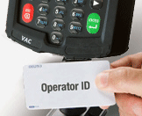
PowerFleet Enterprise Vehicle & Operator Access Control
Reader can match existing employee ID
  Prox/MiFare/iClass/Indala/iButton/etc.
Idle timeout by vehicle type & vehicle
  Ensures access control integrity
  Reduces IC truck PMs/fuel use/emissions
Superior tamper-resistance
Unique features
  Patented group structure for easiest admin & most meaningful data reporting
  Automatic operator expirations (license, training certification, medical), with group control (expiration on one vehicle type does not affect others)
  ‘Driver Break’ allows operators to temporarily control their vehicles
  ‘Temp User’ lets supervisors authorize drivers at vehicle

Slide 8
PowerFleet Enterprise Electronic Safety Checklist
  Event-based for most effective reactions
  Auto-notifications to maintenance/safety
  Reports prioritized by severity of problem
  Moderate impact triggers driver self-checklist
  Severe impact triggers supervisor checklist
  Problem identified on main checklist triggers drill-down sub-checklist
  Multi-language checklists can be triggered
  Configurable Checklist
  Other unique automatic features:
  Randomized answers (no ‘finger-whipping’)
  Auto-verification of checklist answers that require vehicle to be motion (e.g. braking)
  Prompt to stop/park vehicle safely before shutdown (never when vehicle is in motion)
  100% paperless safety audit trail
Benefit: Eliminate paper handling, regulatory compliance and improved maintenance

Slide 9
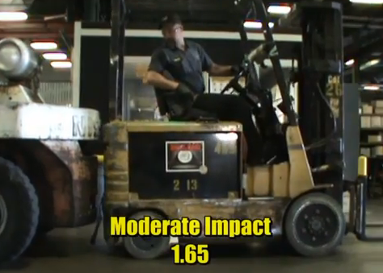
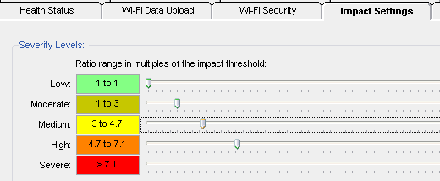
PowerFleet Enterprise Impact Management & Reporting
  Auto-learning sensor easiest to install
  Self-adjusting to reduce false alarms
  5 severity levels
    Automatic, configurable responses to each level
    Background reporting
    Visual and audible alerts
    ‘Driver Checklist’
    Email/text notifications
    Truck shutdown
  Unique ‘Driver Checklist’ for mid-level impacts
    Enables self-policing
      No need for supervisor, no break in productivity
  Post-accident “black box” analysis
  Improve driving habits without false alarms disrupting work

Slide 10
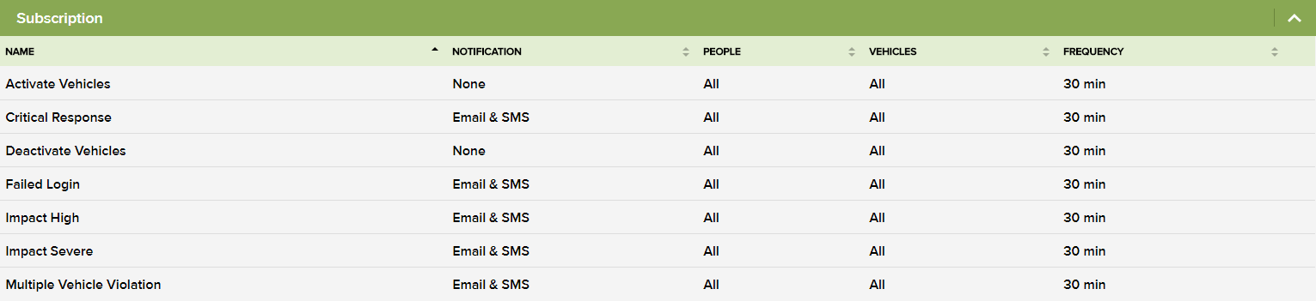
PowerFleet Enterprise Automated Notifications and Alerts
  Configurable by individual
    SMS Text or Email message when event occurs.
    Impacts, Checklist, Lockouts, and more…
  Group vehicles to focus on what you need to know
  Group people to focus on what you need to know

Slide 11
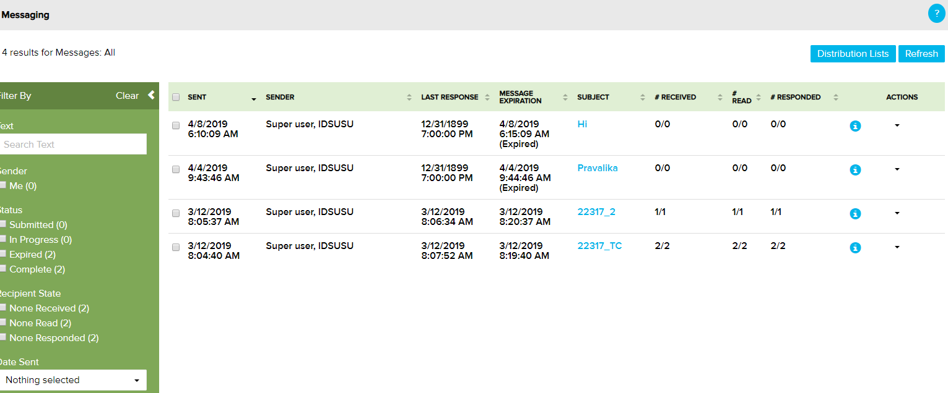
PowerFleet Enterprise Text Messaging
  Unlimited flexibility to target messages
  Individual vehicles and/or operators
  Groups of vehicles and/or operators
  Fleet-wide broadcast
  Flexible 2-way response capability
  Vehicle message follows vehicle no matter who logs in (critical for maintenance reminders)
  Operator message follows him/her to whatever vehicle he/she logs into
  Configurable message expiration times
  Automatic tracking of message receipt by vehicle, when read by driver, and how/when driver responded

Slide 12
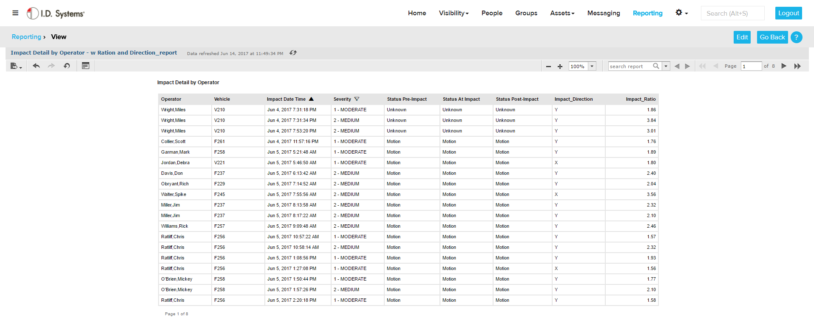
PowerFleet Enterprise Powerful & Flexible Reporting
  Automated reports
  Configure to your needs
  Slice and Dice the data
    Impacts
    Operators
    Vehicles
    Utilization

Slide 13
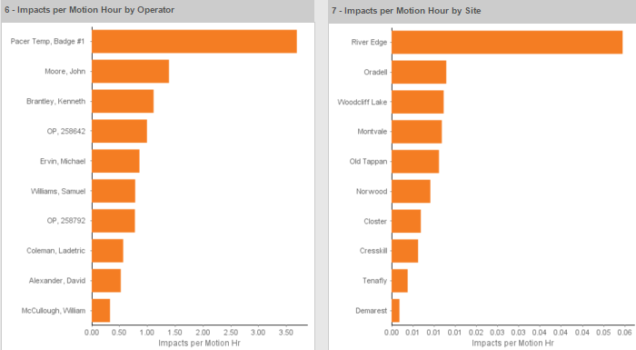
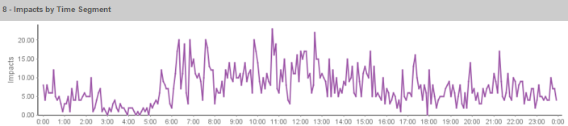
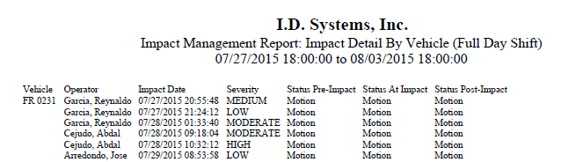
PowerFleet-IQ – Impact Management
Identify those Operators w/ Highest Rate
Improve Safety
Reduce repair costs
Identify Operators for retraining
Save money and lives
Site Histogram based on Highest impact rate
Identify When Greatest Number of Impacts are occurring during the Day

Slide 14



PowerFleet Safety - A Broad Range of Safety Equipment
CAMERA SYSTEMS
SPEED & ABUSE
OTHER
Record exactly what happened before, during and after an incident with both video and audio.
For cable or electronic Throttles. From seatbelt systems to digital speedometers.
Weighing devices, pedestrian safety systems, anti-theft solutions, and fan systems for climate control.

Slide 15




OUR SOLUTIONS

